Slide 1
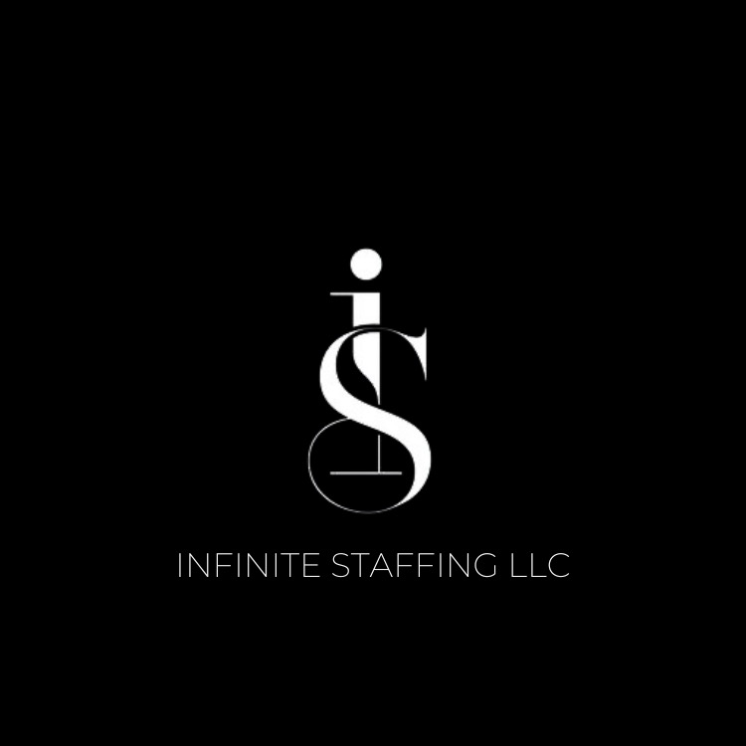
Infinite Staffing, LLC
Infinite Staffing is a Full – Service Employment Agency specializing in meeting and exceeding the Infinite Staffing needs of companies in all industries.
1290 Double Churches Road, Suite N
Columbus, GA 31904

Slide 2
About Infinite Staffing, LLC
Infinite Staffing, LLC is a locally and minority women owned agency.
Full-service professional firm that will handle short-term and longer-term contracts, seasonal and project support, temp-to-hire transitional hiring and direct hire services.
Provides employees specialized in a variety of areas of expertise.
Committed to providing qualified and reliable employees that will best meet your company’s needs.
Infinite Staffing, LLC’s clients know that their positions will be filled with highly qualified employees, and that peace of mind allows them to focus on operations.
Our team consists of Recruiters and Coordinators knowledgeable in the job market.
Our staff is professionally trained and organized to provide service with excellence. Key resource for people seeking new career opportunities and companies seeking qualified personnel.
Committed to diversity, inclusion, employee growth, and respect for the differences we all bring to our common workplace.
We will handle all of the work associated with finding and screening candidates for your openings and handle all payroll for temp and temp – to – hire employees.

Slide 3

Our Services
Temporary Staffing
Temporary Staffing is a great solution for those companies who need a flexible workforce. If your operations are seasonal or you take on short – term projects on a regular basis, temporary staffing can allow you to operate at peak efficiency regardless of your workload. We maintain a large roster of potential temporaries who are pre –screened and ready to begin work on a short notice. This allows you to scale your staff number up when you need it without having the unnecessary personnel cost when things slow down.

Slide 4

Our Services (CONT)
Temp – To - Hire
Many employers have spent dozens of hours screening, interviewing, and training a new employee, only to find out that they’re not the right fit for the company once they’re hired. This can lead to problems throughout your company as lack of productivity and poor morale build. Infinite Staffing, LLC ‘s temp – to – hire services allow you to avoid the hassle associated with finding and screening a candidate, and also gives you a probationary period so that you can be sure your new employee is the right fit for your team. During this probationary period, Infinite Staffing, LLC handles payroll for you, so that you only have to complete internal onboarding processes when you’re sure you’ve found a perfect fit.

Slide 5

Our Services (CONT)
Direct Hire Recruitment (Permanent placement)
When you have a vacancy in a position that is mission – critical, it is important that you find the right individual as quickly as possible. When you are responsible for running your entire business, it can be difficult to find the right person. Infinite Staffing, LLC is always on the lookout for outstanding candidates for sales, administration, management , labor, mechanics and technical fields. When you have an important vacancy, our Recruiters immediately schedule interviews with candidates that Infinite Staffing, LLC has personally screened and selected based on your requirements.

Slide 6

Our Services (CONT)
Fee Schedule
At Infinite Staffing, LLC, we pride ourselves on simple to understand and reasonable fees. While other companies vastly inflate your personnel costs, or confuse you with multiple fees, we charge a simple rate for our services.
Temporary Employees - are billed at a simple hourly rate based on position. Temporary Employees will remain on Infinite Staffing, LLC’s payroll for 90 days for 480 billable hours. If a client wishes to hire the Temporary Employee before the 90 days is up, Infinite Staffing will apply a one – time fee based on billable hours worked.
Direct Hire Employees – are billed a one – time fee equal to permanent rate of their expected annual wages.

Slide 7

Infinite Staffing, LLC Services
Customized and Infinite Recruiting
Screening and Selection of all Applicants
Drug Screen (100%-all temporaries)
Criminal Background Check (100%-all temporaries)
Personal Interview with each applicant
Reference checks
I-9 and Social Security Verification (E-Verify)
WC, UC, FICA, State & Federal Taxes
Management of Workers Compensation
Management of Unemployment Claims
Safety Orientation
Infinite Staffing, LLC Orientation
Tutorials and Training on MS Office to enhance temporaries’ skill levels.
Precise Invoicing
On-Call-Staff member available 24/7 for assistance with staffing needs.
Dedicated Recruiter to your account
Onsite Manager provided by Infinite Staffing, LLC for clients with 20 or more Temporary Employees

Slide 8

Pricing Structure
CLERICAL POSITIONS WILL BE AT 40% Mark up (Customer Service/Receptionist/ Finance/IT and Lab)
INDUSTRIAL POSITIONS WILL BE AT 45% Mark up (Laborer/Mechanics/ Plant Operations)
PRODUCTION POSITIONS WILL BE AT 35% Mark up
(General Laborers, Forklift)
EXAMPLE:
  Position- Labor
  Employee Pay-rate: $15.00/hour
  CLIENT BILL-RATE: $21.75/hour
Infinite Staffing, LLC includes a 100% satisfaction guarantee on all our temporaries. If you are not satisfied with our temporary within the first four hours of work, you will not be billed!
Conversion from Temp-to-Hire: Many companies use temporaries to “try” before you “buy” to allow management to fully evaluate the skills and abilities of an employee before accepting the liabilities of full-time employment. Our customized recruiting program enhances this process.
Weekly or Monthly Reviews- Infinite Staffing, LLC will meet with each client on a weekly or monthly basis (depending on your needs) to review our performance and set specific objectives for improvement for the following week and/or month.

Slide 9

We Look Forward to Meeting and exceeding All of Your infinite Staffing Needs
Phone: 706.221.1202 or 706.477.7583
email: infiniterecruitmentllc@gmail.com
1290 Double Churches Road, Suite N. Columbus, GA 31904

